Slide 1



Data Analysis

Slide 2


Today's agenda
Project recap
Problem
The Analytics team
Process
Insights
Summary

Slide 3

S
Social Buzz is a fast growing technology unicorn that need to adapt quickly to it’s globle scale.
Accenture has begun a 3 month POC focusing on these tasks:
An audit of Social Buzz’s big data practice
Recommendations for a successful IPO
Analysis to find Social Buzz’s top 5 most popular categories of content
Project Recap

Slide 4

Problem
Over 100000 posts per day
36,500,000 pieces of content per year!
But how to Capitalize on it when there is so much?
Analysis to find Social Buzz’s top 5 most popular categories of content
Notes:
Focusing on the last point mentioned, this is what the Data Analytics team has been specifically focused on.
With such a grand scale, there comes a lot of data, and with vast amounts of data come challenges.
To provide background on the magnitude of data creation:
You informed us that your platform receives over 100,000 posts per day, totaling 36,500,000 posts every year. All of this data is unstructured, making it challenging to make sense of.
In this digital era, content reigns supreme. Just observe some of the largest platforms globally, such as YouTube, Facebook, and Netflix — they are all content-driven businesses.
However, how can one capitalize on such abundance?
It's not merely about accumulating as much content as possible. The true value lies in comprehending and analyzing this content to gain deeper insights into your audience and, consequently, providing a more personalized and enjoyable experience.
This is where our data analytics expertise comes into play. With the insights we've uncovered from this task, we can demonstrate precisely how to implement analytics at scale.

Slide 5



ANDREW FLEMING
Chief Technology Architect
The Analytics team
MARCUS ROMPTON
Senior Principal
SHAIKH MINHAJ
Data Analyst

Slide 6
1
Data Understanding
2
Data Cleaning
3
Data Modelling
4
Data Analysis
5
Uncover Insights

Slide 7

Insights
16
Unique Categories
Animal
Most Favorite Category
May
Month with
Most Number of posts

Slide 8
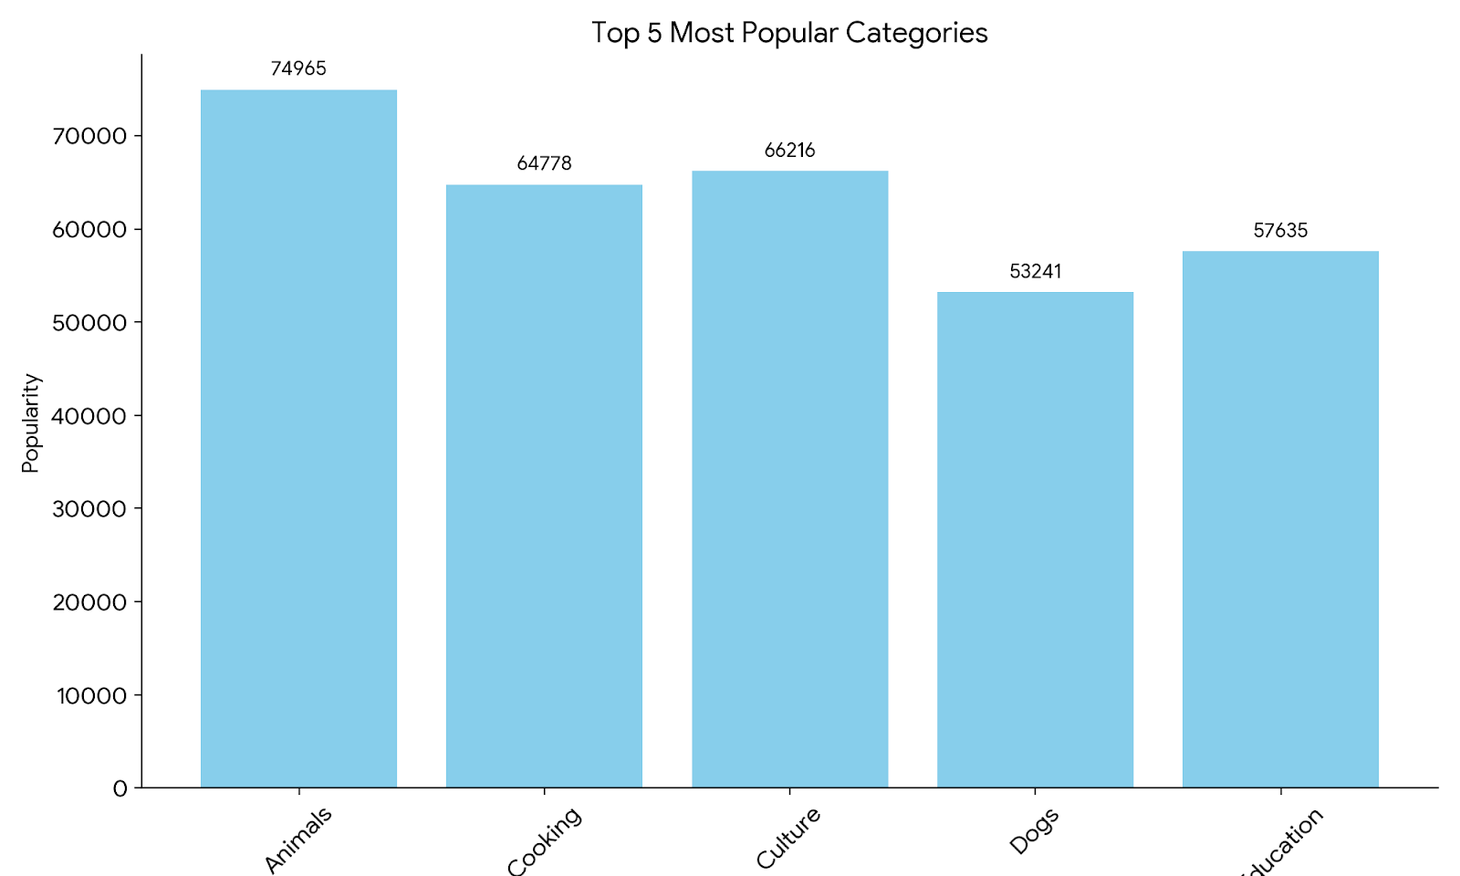

Slide 9

ANALYSIS
Science and Technology are the most popular categories of content showing that people enjoy “real-life” and “factual” content the most.
INSIGHT
Food is a common theme with the top 5 Categories with “Science” ranking the highest. This may give an indication to the audience within your user base. You could use the insight to create a campaign and work with healthy eating brands to boots user engagement.
Summary
NEXT STEPS
This ad-hoc analysis is insightful, but it’s time to take this analysis into large scale production for real-time understanding of your business. We can show you how to do this.

Slide 10
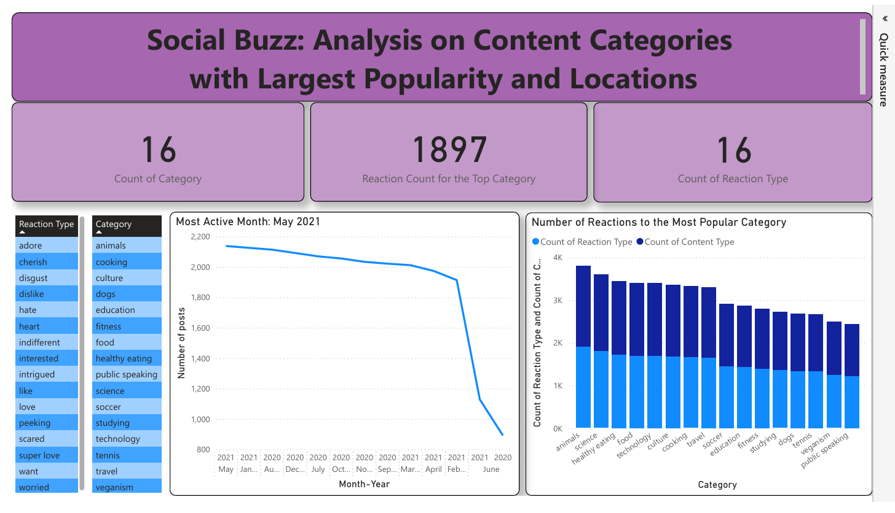

Slide 11
Thank you!
ANY QUESTIONS?

